Slide 1
Machine Learning (IS ZC464) Session 14:Instance Based Learning

Slide 2
Instance Based Methods
Training instances are stored but no generalization is done before an instance for testing arrives.
No hypothesis using training input output pairs is constructed.
A new instance is examined with respect to all training instances (observations) and is given its target value.

Slide 3
Lazy Learning
These methods are sometimes referred to as “lazy” learning methods because they delay processing until a new instance must be classified.
The target function is not estimated once for the entire input (instance) space.
The target label or class of the new instance is computed locally or differently when it comes.

Slide 4
What does it mean by lazy learning?
The neural network based classifiers learn the training data and acquire knowledge in terms of weights. The classifier thus is ready for new testing instances.
While the instance based methods keep using the training data from its memory without learning any knowledge from the data.
Every new instance requires the entire training data to be processed due to which classification is delayed and is called lazy learning.

Slide 5
Instance based methods
K-Nearest Neighbor Learning
Locally Weighted Regression

Slide 6
k-nearest Neighbor Learning
This algorithm assumes all instances correspond to points in the n-dimensional space ℜ.
The nearest neighbors are defined in terms of the Euclidean distance.
Let an arbitrary instance ‘x’ be described by the feature vector (a₁(x), a₂(x), …, a_{n}(x)) where a_{r}(x) is the value of the r^{th} attribute of instance x.

Slide 7
Distance measure
The distance between two instances xi and xj is defined by d(xi, xj) where
The target function in nearest neighbor learning may be either discrete valued or real valued.

Slide 8
K-Nearest Neighbor Algorithm
Consider the following two dimensional points belonging to two different classes represented as two colors
The points are representing training instances by the corresponding feature vectors.
The feature vector is an x,y coordinate pair for each point

Slide 9
K-Nearest Neighbor Algorithm
Let a new testing instance arrives (shown as blue dot) and is plotted on the same coordinate plane
The k-nearest neighbor algorithm requires ‘k’ to be defines as a value.
For example if k=3, we compute the distances of the new instance from all training data and mark three closest points

Slide 10
K-Nearest Neighbor Algorithm
The three closest neighbors are marked as double bordered circles with respective colors as class labels
As two yellow colored instances are close to the new testing instance (blue) out of the three closest neighbors, we assign the class (with yellow color as label) to the testing instance

Slide 11
Classification as mapping
Define f: ℜ^{n} → V
Where V = {v₁, v₂, ..v_{s}} set of class labels
And ℜ^{n} is the n-dimensional space
A value f(x_{q}) represents the class label to which the testing sample x_{q} belongs to

Slide 12
Which class should be assigned to the testing sample x_{q}?
Define a function δ as follows
δ(a,b) = 1 if a=b
0 otherwise
δ(v,f(x_{i})) gets a value 1 if the class of training data x_{i} is v. This value contributes in the classification
The class of the test instance x_{q} is given by

Slide 13
1-Nearest Neighbor Learning
This method selects value of k as 1 and assigns the target class to the testing instance of the training instance which is nearest to it.
Of the samples around the testing sample, the nearest one is seen and its corresponding class is assigned to the testing sample

Slide 14
Classification accuracy may change if k changes
1-NN assigns the class label 1 (red)
3-NN assigns the class label 2 (yellow)
4-NN has 2 yellow and 2 red nearest samples ➔confusion
5-NN assigns class label 1 (red)

Slide 15
Distance Weighted Nearest Neighbor Algorithm
The contribution of the k-neighbors is weighed according to their respective distance from the given test data point.
More weight is given to the training data of the k nearest points being the closest while the points at father distance are given less weight.

Slide 16
Weight
The weight w_{i} of the i^{th} training point at distance d(x_{i}, x_{q}) is inverse of square of the value of d(x_{i}, x_{q}).

Slide 17
Which class should be assigned based on weights?
Define a function δ as follows
δ(a,b) = 1 if a=b
0 otherwise

Slide 18
Example
5-NN
Let the distances of the training instances of class 1 be 4, 6 and 2 and those of the class 2 be 2 and 3
Compute the class label
Compute for class 1: 1/(4)² ,1/(6)² , 1/(2)² which are 0.0625, 0.0277, 0.25 sum of which is 0.3402
Compute for class 2: 1/(2)² ,1/(3)² which are 0.25 and 0.1111 respectively, sum of which is 0.3611
Class 2 is assigned to the test sample.

Slide 19
Case based Reasoning
Case based reasoning (CBR) is a learning paradigm based on which resembles the k-Nearest Neighbor method in that
it defers the decision on how to generalize beyond the training data until a new test instance is observed
Classify new test instances by analyzing similar instances that are very different from the test instance

Slide 20
Case based Reasoning
In CBR, the instances are typically represented using more rich symbolic descriptions, and the methods used to retrieve similar instances are correspondingly more elaborate

Slide 21
Examples of CBR
Design of mechanical devises based on a stored library of previous designs
Reasoning about new legal cases based on previous rulings
Solving planning and scheduling problems by reusing and combining portions of previous solutions to similar problems

Slide 22
Locally Weighted Regression
K-NN is visualized as a function approximation in a local area surrounding the test instance.
This motivates to think of formulating multiple local hypothesis covering the entire training data.
Local regions

Slide 23
Locally weighted regression
The phrase “locally weighted regression” is called local because the function is approximated based only on the data near the query point (test instance)
Let x_{q} be the test instance, then a function f() is constructed around the test instance.
Once the classification or target labeling to the test instance is done, the function f() is refreshed to be defined for a new test instance.

Slide 24
Locally Weighted Linear Regression
Function approximation near x is given as
Where a_{i}(x) is the value of i^{th} attribute of the instance x
This was a global approach
Question: Which method is used to compute the parameters w
Delta rule you studied earlier says
W_{j} = W_{j} - ∆w_{j}
= W_{j} + ∑_{i} T_{i*} g’* x^{i}_{k}
Notations refer to earlier discussions
Answer : Gradient descent

Slide 25
Locally weighted linear regression
Minimize the error over just k nearest neighbors (training instances) of the test instance x_{q} and not on all instances.
One approach that bridges the distance weighted regression and neural network based learning is radial basis functions

Slide 26
Generalization in Classification Problem
Generalization
If the test feature vector can be correctly classified
Y
K-NN performs poorly in these situations
Test vector
o
X
RBFNN: Each class is separately handled by separate RBF units

Slide 27
Data is linearly separable in higher dimensional space (Cover’s Theorem)
Example
φ₁(x)= x₁²
φ₂(x)= x₂²
φ₃(x)= √(2x₁x₂)
Where x =<x1,x2>
Φ: x → φ(x)
Figure Source: www.cs.utexas.edu/~mooney/cs391L/slides/svm.ppt‎

Slide 28
Multi Layer Perceptrons
These are acyclic directed graphs.
MLP is a feedforward neural network.
Can handle non linearly separable data.
Have different hidden layers of neurons which process the data.
Training is through weight learning.
i^{th} layer passes information to i+1th layer

Slide 29
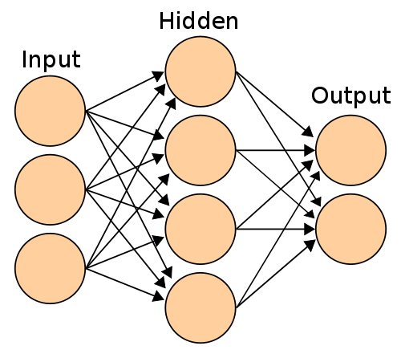
MLP

Slide 30
Radial Basis Functions Neural Network (RBFNN) Architecture
RBFU
input vector
Weights
x₁
x₂
x_{d}
Input Layer
Hidden Layer
Output Layer

Slide 31
Why More neurons?
More number of classes.
Large input sizes of the patterns
Nonlinear separability of clusters in n-dimensional space.

Slide 32
RBFNN
They capture the training environment in terms of weights.
The radial basis functions units (RBFU) locally capture the structure of the data
Basis functions at the RBFU play an important role in transforming the nonlinearly separable high dimensional data to a space of linearly separable data.

Slide 33
Multi Layer Perceptron Vs. RBFNN
Decision Boundary : Hypersphere
Decision Boundary : Hyperplane
The center of the natural cluster is the center of the hidden neuron
A hidden neuron is sensitive for data points near its center

Slide 34
Nearest Neighbor Classification Vs. RBFNN based classification
+
“Do not know “ condition can be handled well by RBFNN
Test feature
+
Nearest neighbor: Shortest distance to the mean of the cluster
RBFNN: Within limits of Radial distance to the mean of the cluster

Slide 35
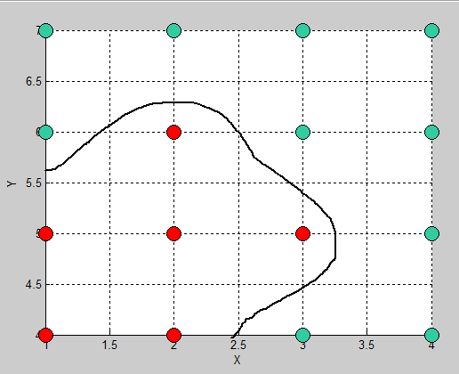
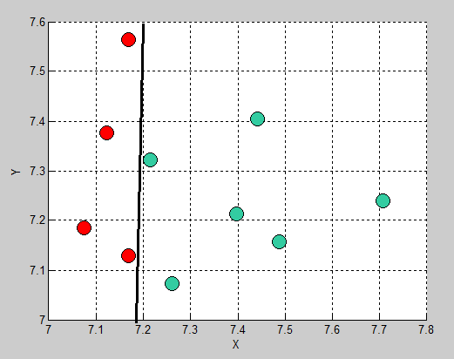

Basis Functions
Dimension of the hidden layer is equal to the number of neurons in it.
Basis Functions transform the input feature space to the hidden space
Input space : <f₁,f₂>
Hidden Space: <φ₁ ,φ₂>

Slide 36
Basis Functions
Let x = < x₁,x₂,x₃,....x_{d}> be the feature vector.
Let c_{i} be the center of the ith RBF unit.
φ_{i} (x) is a function of the radial distance of vector x from the center c_{i}

Slide 37



RBFNN and basis functions
input vector
x₁
y₁
x₂
x_{d}
Input Layer
Hidden Layer
Output Layer
Input vector size = d
Number of neurons= k
Output = m

Slide 38

RBFNN
Input layer
Takes as input the d-dimensional feature vector
Input layer size = d
No Mapping at input layer
Hidden Layer
Nonlinear Transformation
Hidden layer size = K (no of neurons)
Output Layer
Linear Transformation y = h(x)
Output layer size = m (number of classes)

Slide 39
Issues in the design of Hidden Layer of the RBFNN
Center Selection
Spread
Choice of Basis functions
Number of neurons
√
√
√

Slide 40


Radial Basis Functions (kernel functions)
Gaussian
Multiquadric
Inverse Multiquadric
Thin Plate Spline

Slide 41
RBF neural network
It learns a global approximation using the local tuning of the neurons.

